Slide 1
A Closer Look at the Repositories World
Matheus Lourenço, PhD
Inspired by session 2024 by Bruna Piereck, PhD
May 2025

Slide 2

Before we begin
Computers necessary for discussion moments?
Computers open for exercises with closed apps (teams, outlook, WhatsApp, etc) ?
What else?

Slide 3
Disclaimer: I will not tell you which repository to use in your research.
!

Slide 4
A Closer Look at the Repositories World
Why use a repository
How to find repositories
How to choose a repository
A word on re-usability

Slide 5
01
Why

Slide 6
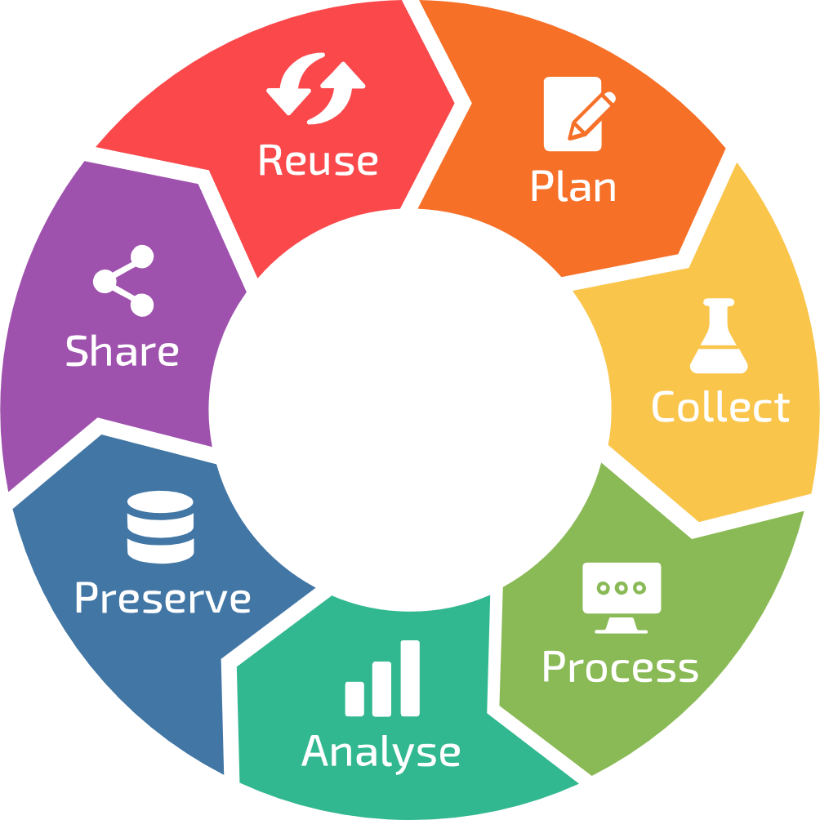
Where to start?

Slide 7
The stick approach
It is a requirement of:
Journals,
Funders,
Institutions,
Etc.
Simply said: you must do it.

Slide 8
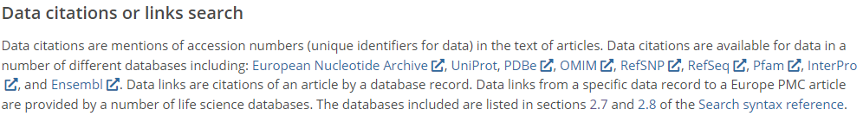
The carrot approach
Future proofing for yourself
Increased citations:
https://europepmc.org/Help#searchdata

Slide 9
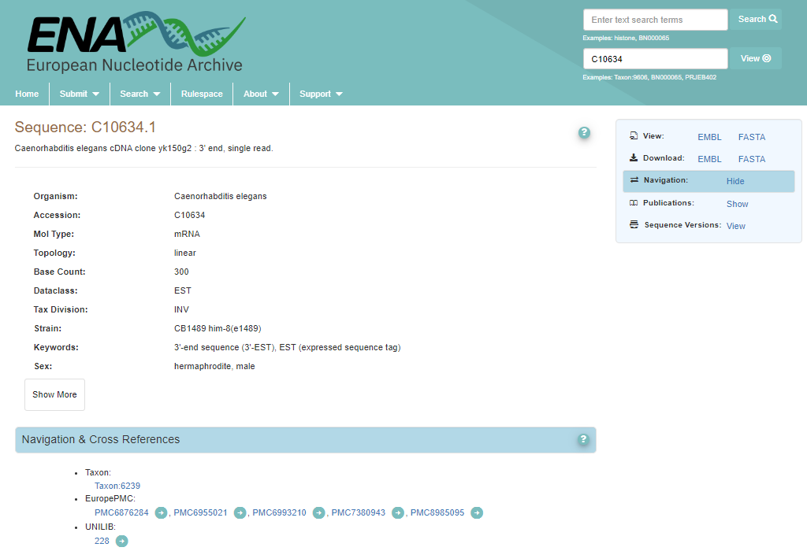
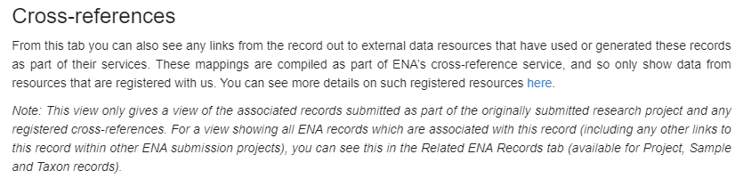
Example:

Slide 10
The carrot approach
Future proofing for yourself
Increased citations:
Visibility and networking possibilities
In other words: You want to do it!
https://europepmc.org/Help#searchdata

Slide 11
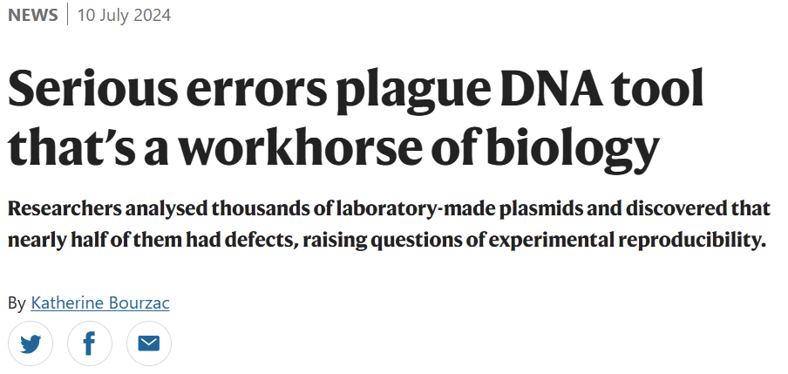
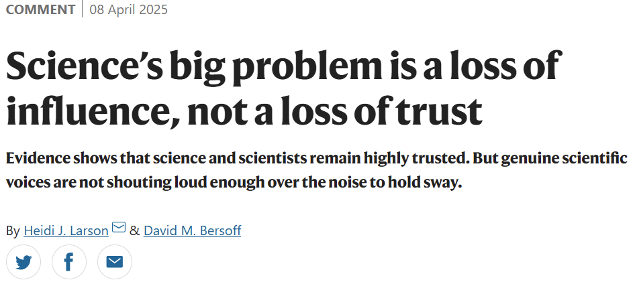
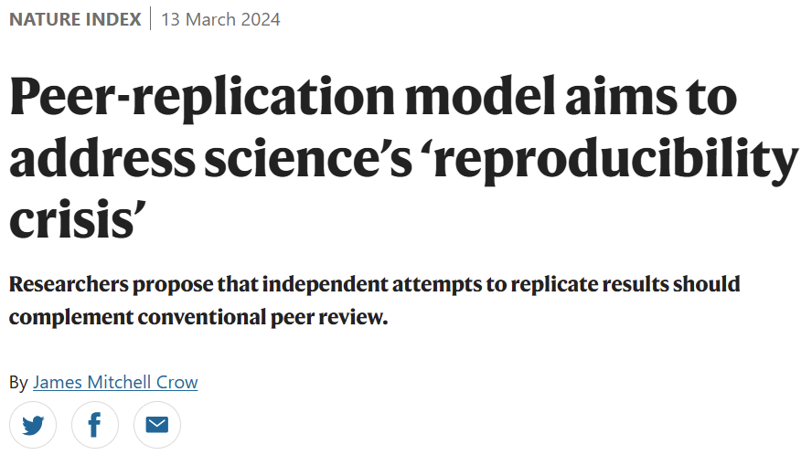
Scientific Integrity
Why are you in science?
What about the reproducibility crisis?
Strengthen public trust through communication.

Slide 12
02
How to find repositories

Slide 13

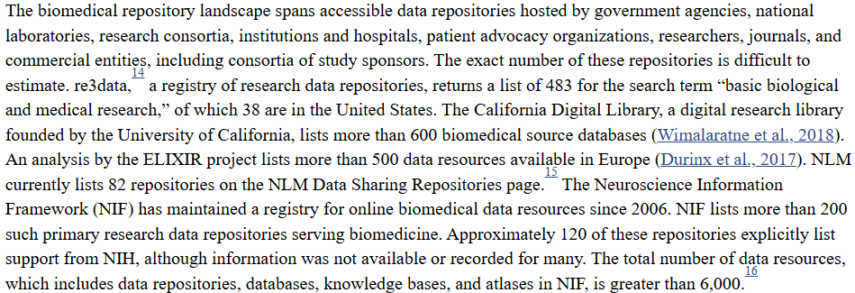
There are hundreds of repositories available
Introduction - Life-Cycle Decisions for Biomedical Data - NCBI Bookshelf (2020)

Slide 14
Tools for finding repositories
Re3data.org
Fairsharing.org
Elixir-Europe.org/platforms/data/elixir-deposition-databases
Ebi.ac.uk/submission/
AI (e.g. co-pilot)
Etc… (check RDMkit for more)

Slide 15
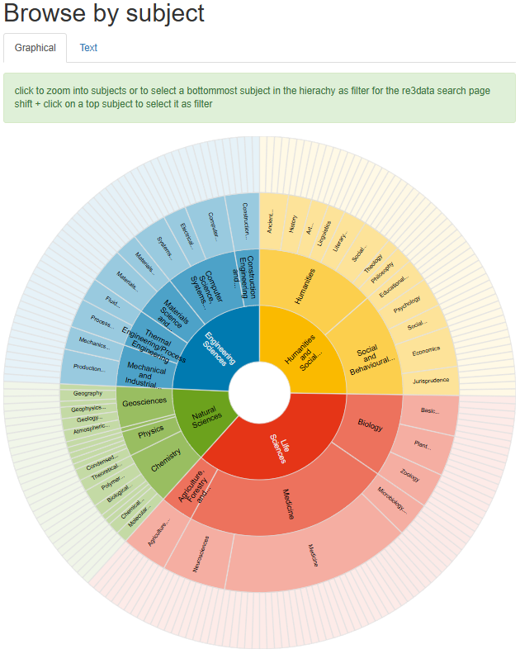

Go to and explore the number of repositories in your field

Slide 16
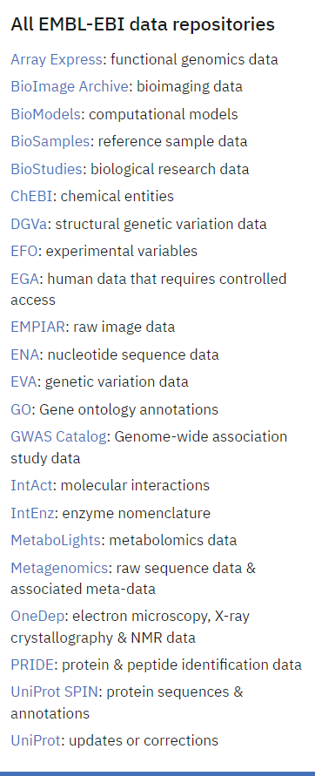

The data wizard:

Slide 17

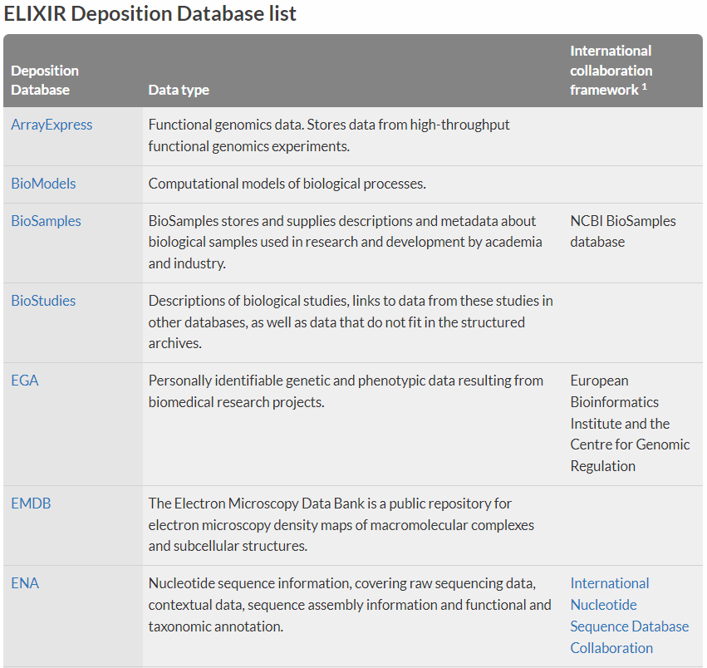
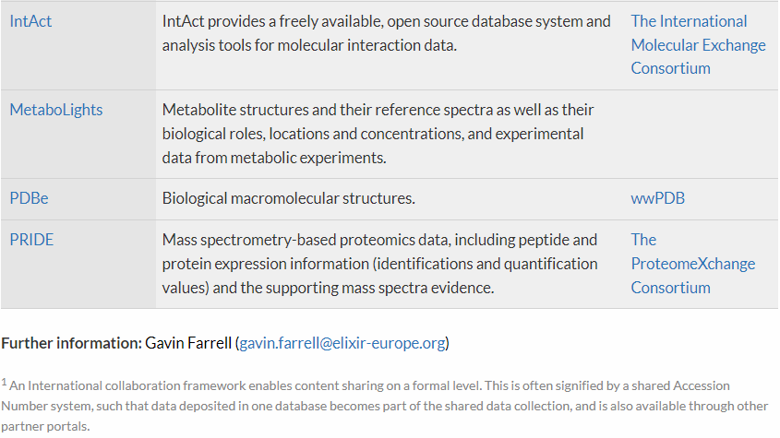
ELIXI Deposition Database list
ELIXIR Deposition Databases for Biomolecular Data | ELIXIR (2017)

Slide 18
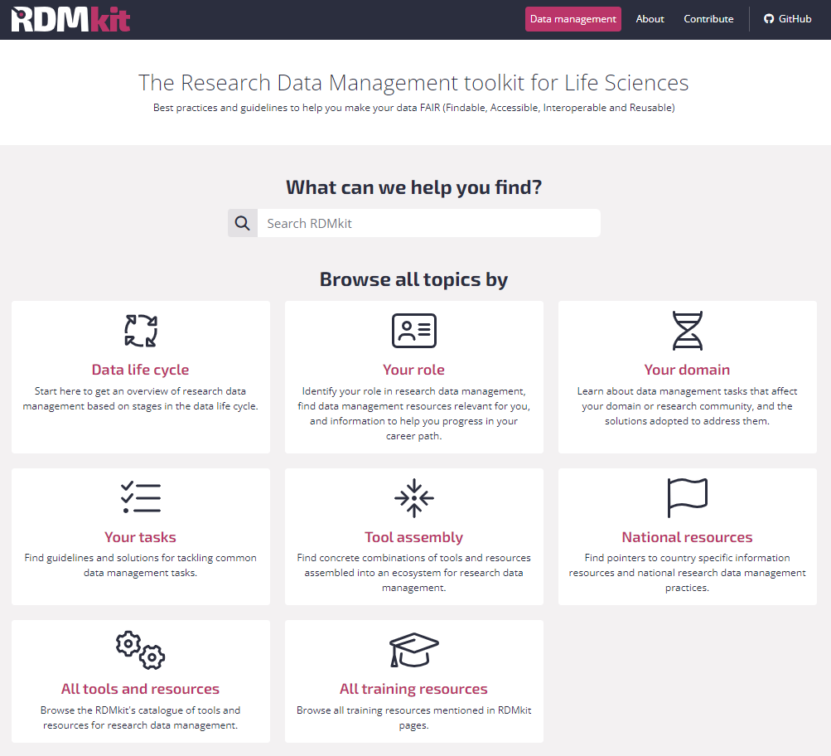

Community driven:

Slide 19
Alice
She is a researcher who:
Works with plants
Is generating whole genome sequencing data
Makes use of several public platforms for tools and data
Has the current project funded by a public agency
Aims at publishing work in an open peer reviewed journal
Suggest a couple of repositories based on the RDMkit that are domain specific
Justify your choice
Think about that info you can find about the repository

Slide 20
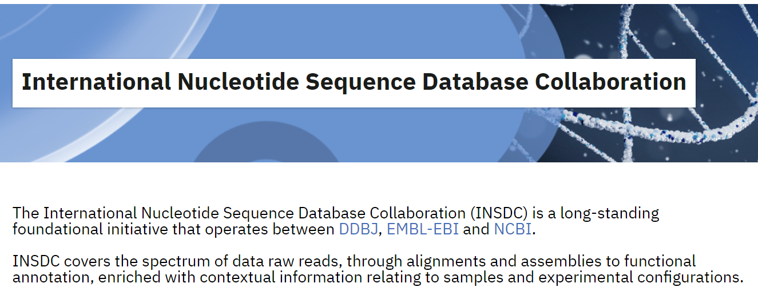
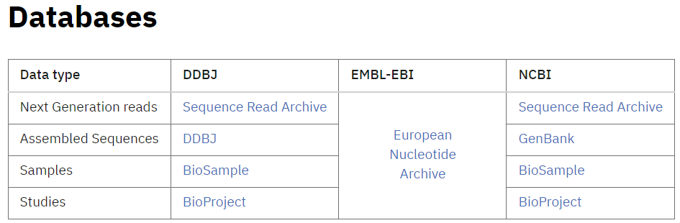
Multiple repositories with similar data type
https://www.insdc.org/

Slide 21



Genomics

Slide 22
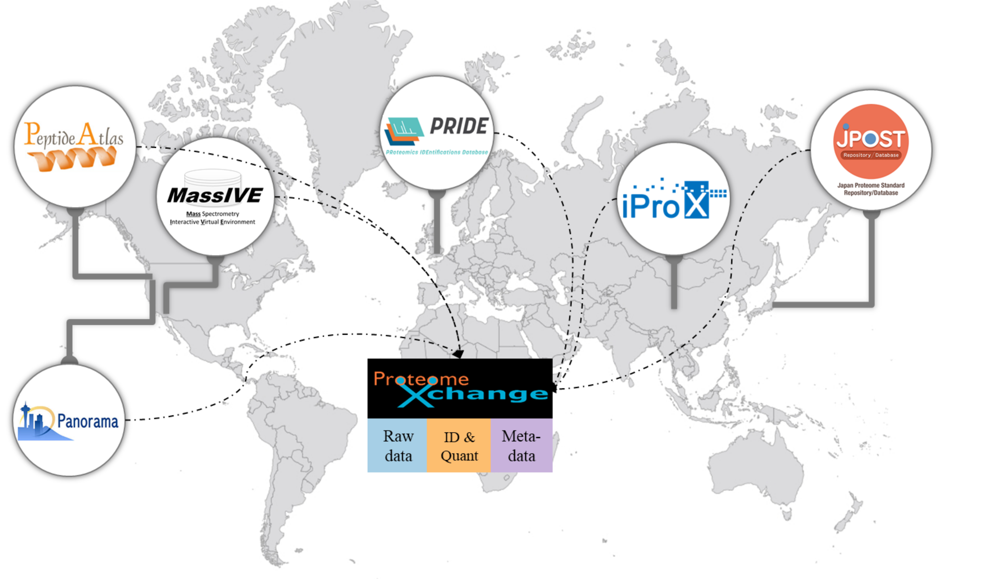
Proteomics
proteomexchange.org

Slide 23

Metabolomics
MetabolomeXchange

Slide 24


The Omics Discovery Index (OmicsDI)
OmicsDI is part of the ELIXIR infrastructure
25 Resources, >3M datasets, 4 Continents

Slide 25
Alice is back
Still working with plants
Is generating whole genome sequencing data
Makes use of several public platforms for tools and data
Has the current project funded by a public agency
Aims at publishing work in an open peer reviewed journal
Is also generating proteomics data
Is also generating metabolomics data
Would like that the datasets are recognized as to belonging to the same project
Find suitable domain specific repositories and a way to connect these datasets

Slide 26



Multi-omics

Slide 27



Multi-omics
BioSamples
BioSamples
BioSamples
BioSamples

Slide 28

Multi-omics
BioSamples
BioSamples
BioSamples
BioSamples

Slide 29

A side note on human sensitive data
“a service for permanent archiving and sharing of personally identifiable genetic, phenotypic, and clinical data generated for the purposes of biomedical research projects or in the context of research-focused healthcare systems.”
!
Data access defined, including Data Access Committees (DAC). Different datasets may have different DACs. However, VIB members must contact René Custers before submitting data to EGA: rene.custers@vib.be

Slide 30
Access types
Open access: Data is shared publicly. To use open-access researchers need to ensure that the data is anonymized, which is difficult and sometimes impossible in practice.
Registered access: Data is shared with researchers, who have been vouched for by their institution and who agree to abide by data usage policies. Datasets that are shared via registered-access would typically have no restrictions besides the condition that data is to be used for research.
Controlled access: Access is reviewed and approved by a data access committee (DAC). Typically, researchers who were involved in the primary collection of data will form the DAC. There can be a multitude of usage conditions, including allowed research topics, geographical regions, and recipients e.g. non-profit organizations.
At VIB, a DAC may already have been created. Always check with René Custers: rene.custers@vib.be

Slide 31
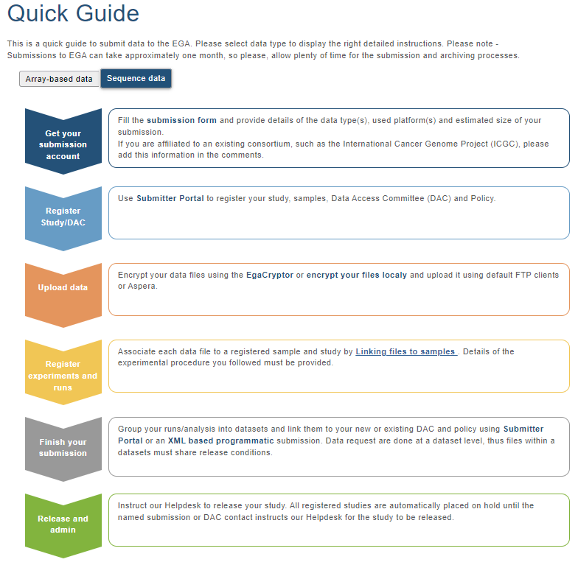
Submitting data to the EGA
https://ega-archive.org/submission/quickguide

Slide 32

A Federated option
The data does not leave the Local EGA (i.e. your country), while it is still discoverable through the Central EGA

Slide 33
03
How to choose a repository

Slide 34
Do you have to choose?
?
University requirements
Journal requirements
DMP requirements
Funding requirements
Ethical and legal requirements

Slide 35
If you do have to choose
Think strategically
Think about your selected audience
Think about how general vs specific you want to go
Think about your values

Slide 36
An example:
A single study has the following topics within it:
Tinnitus treatment
Cognitive Behaviour Therapy
Data on Ecological Momentary Assessment (EMA)
Data on n-of-1 trials
In which journal should you publish the data?
Which repository should you use?

Slide 37
Before you submit!
Different repositories have different rules:
What files are expected?
What metadata is expected?
Can ontologies and controlled vocabularies be used?
Are costs involved?
Is there a license requirement (or is it implicit)?

Slide 38
Before you submit!
Different repositories have different rules:
What files are expected?
What metadata is expected?
Can ontologies and controlled vocabularies be used?
Are costs involved?
Is there a license requirement (or is it implicit)?

Slide 39
04
A word on re-usability

Slide 40
352358 unknown entries in OmicsDI
!

Slide 41
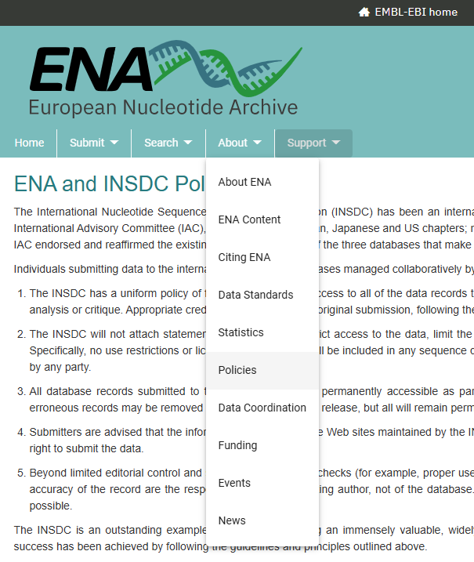
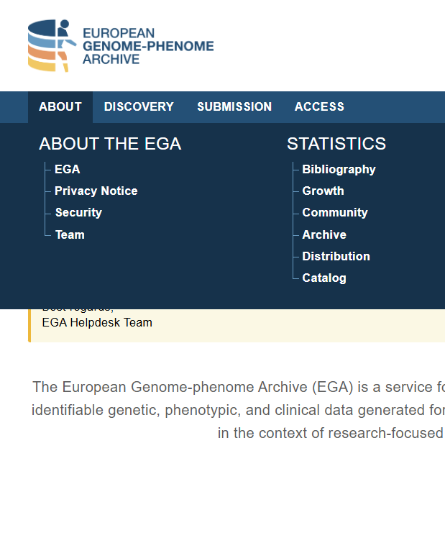
Check licenses for re-se and before submitting

Slide 42
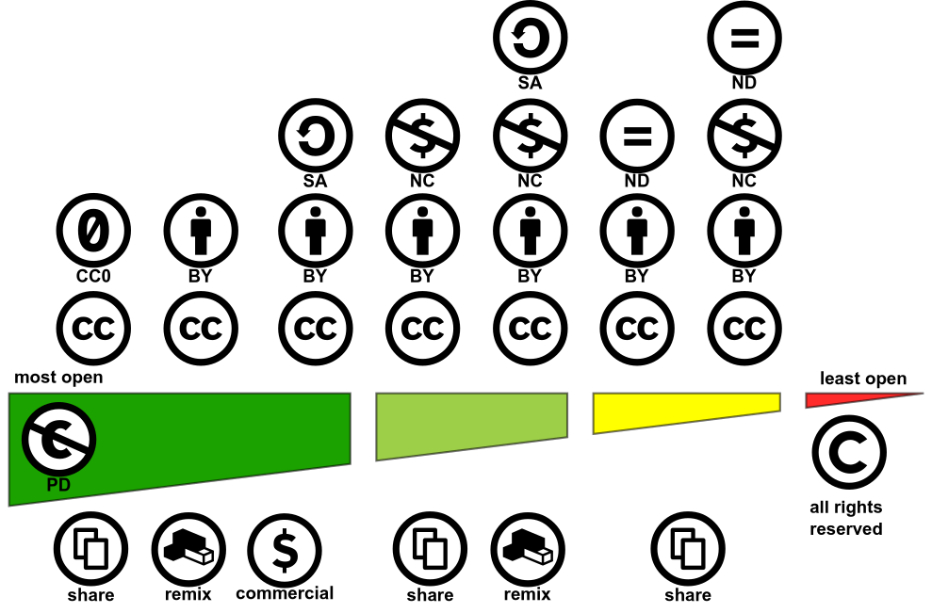

Creative Commons: A license for you
https://creativecommons.org/choose

Slide 43
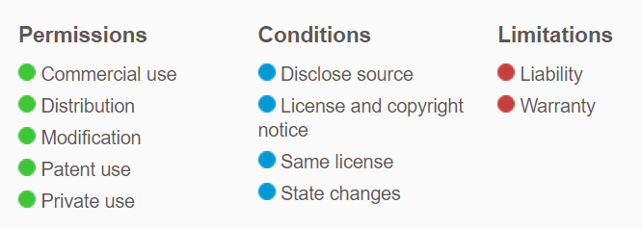

License for other uses: codes
GNU GPLv3:
GNU AGPLv3: Complete source code modifications need to be available
GNU LGPLv3: Large modifications can be distributed under different license.
MIT license: No attribution license
Apache 2.0 ~ GNU PLv3

Slide 44

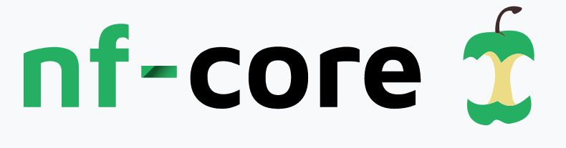





It does not end there…
Computational workflows can also be deposited and shared:
Platform/system specific repositories
Git Based repositories
Generalist repositories

Slide 45
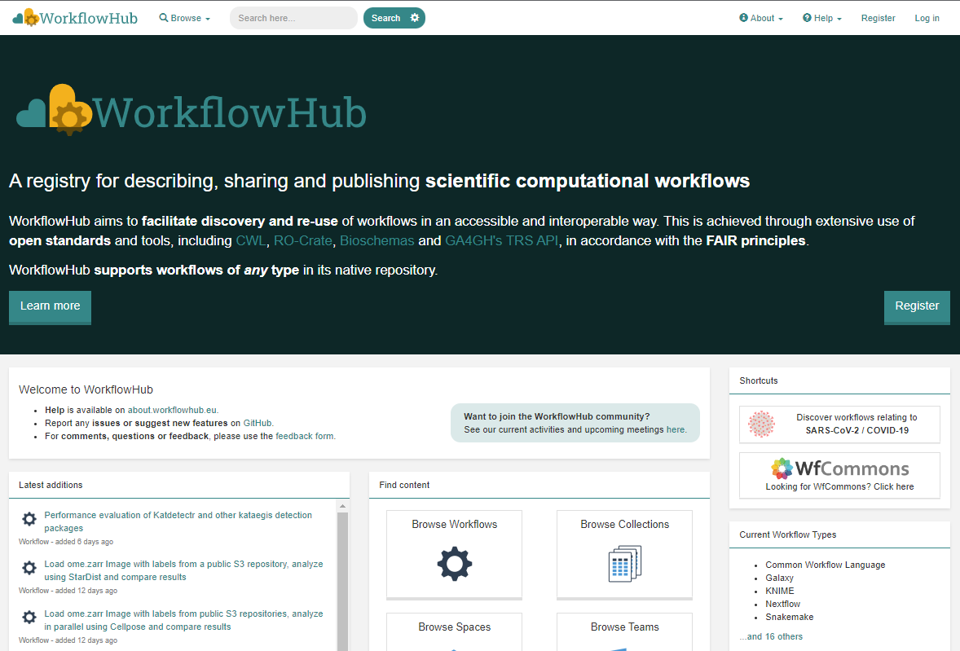
Use a registry to overcome fragmentation
System agnostic
Native repository support
Git integration
Versioning
Links to external files (docs, test and reference data)
Metadata extraction and standards
Integration with Bio.tools
Author credit
Citable
DOI minting

Slide 46


Elixir is here to help!
info@elixir-belgium.org
https://www.elixir-belgium.org

Slide 48
Aqua
HEX #02A2A7
RBG 2, 162, 167
Orange
HEX #EC6523
RBG 236, 101, 35
Purple
HEX #693A91
RBG 105, 58, 145
Navy
HEX #14274C
RBG 20, 39, 76
Blue
HEX #1F448F
RBG 31, 68, 143
Cherry
HEX #E83050
RBG 232, 48, 80
Green
HEX #00A14A
RBG 0, 161, 74
Yellow
HEX #F9B418
RBG 249, 180, 24
Tint 01
HEX #29B3B8
RBG 41, 179, 184
Tint 01
HEX #EF7739
RBG 239, 119, 57
Tint 01
HEX #784B9A
RBG 120, 75, 154
Tint 01
HEX #24539F
RBG 36, 83, 159
Tint 01
HEX #EC4D6A
RBG 236, 77, 106
Tint 01
HEX #1AAF5E
RBG 26, 175, 94
Tint 01
HEX #FCC747
RBG 252, 199, 71
Tint 02
HEX #99D7D6
RBG 153, 215, 214
Tint 02
HEX #F7C1A3
RBG 247, 193, 163
Tint 02
HEX #C2AFD0
RBG 194, 175, 208
Tint 02
HEX #A1B2D5
RBG 161, 178, 213
Tint 02
HEX #F6AAB9
RBG 246, 170, 185
Tint 02
HEX #9BD3B3
RBG 155, 211, 179
Tint 02
HEX #FCE39B
RBG 252, 227, 155
Tint 03
HEX #CBEAEC
RBG 203, 234, 236
Tint 03
HEX #FBE8DF
RBG 251, 232, 223
Tint 03
HEX #E3DCEA
RBG 227, 220, 234
Tint 03
HEX #D5DBEC
RBG 213, 219, 236
Tint 03
HEX #FCE3E6
RBG 252, 227, 230
Tint 03
HEX #D1EAD9
RBG 209, 234, 217
Tint 03
HEX #FEF4CF
RBG 252, 244, 207

Slide 49
Matheus Lourenço: Matheus.lourenco@vib.be

